Slide 1


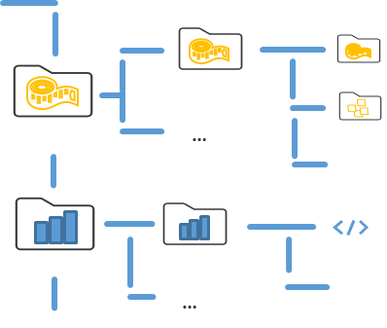



Notify your colleagues
PLANTdataHUB instance
ARC
Issues
…
…
CWL
ARC
Issues
….
….
….
Notes:
But we can we also directly discuss project specific issues online using the datahub online.

Slide 2
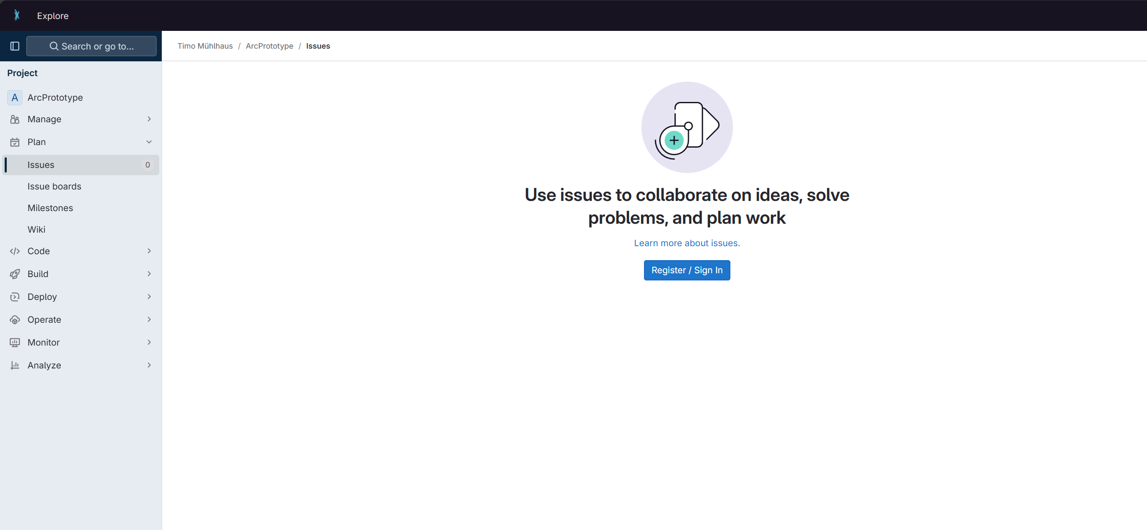
PLANTDataHUB live

Slide 3

FAIR data publication
annotation
reference
research data
journal publication
reference
journal publication
“Digital change starts with a change in mind set of all researchers”

Slide 4


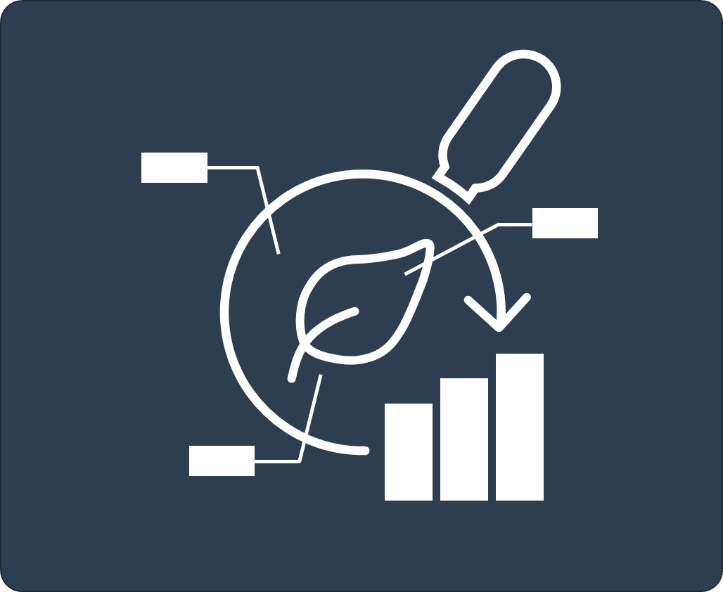
Automatization: “Build, deploy, and validate”
…
build
A
B
C
D
+
ARC Scaffold
check-in
deploy
validate
ARC-RO-Crate
[JSON-LD]
result
Continuous integration for seamless interoperation

Slide 5
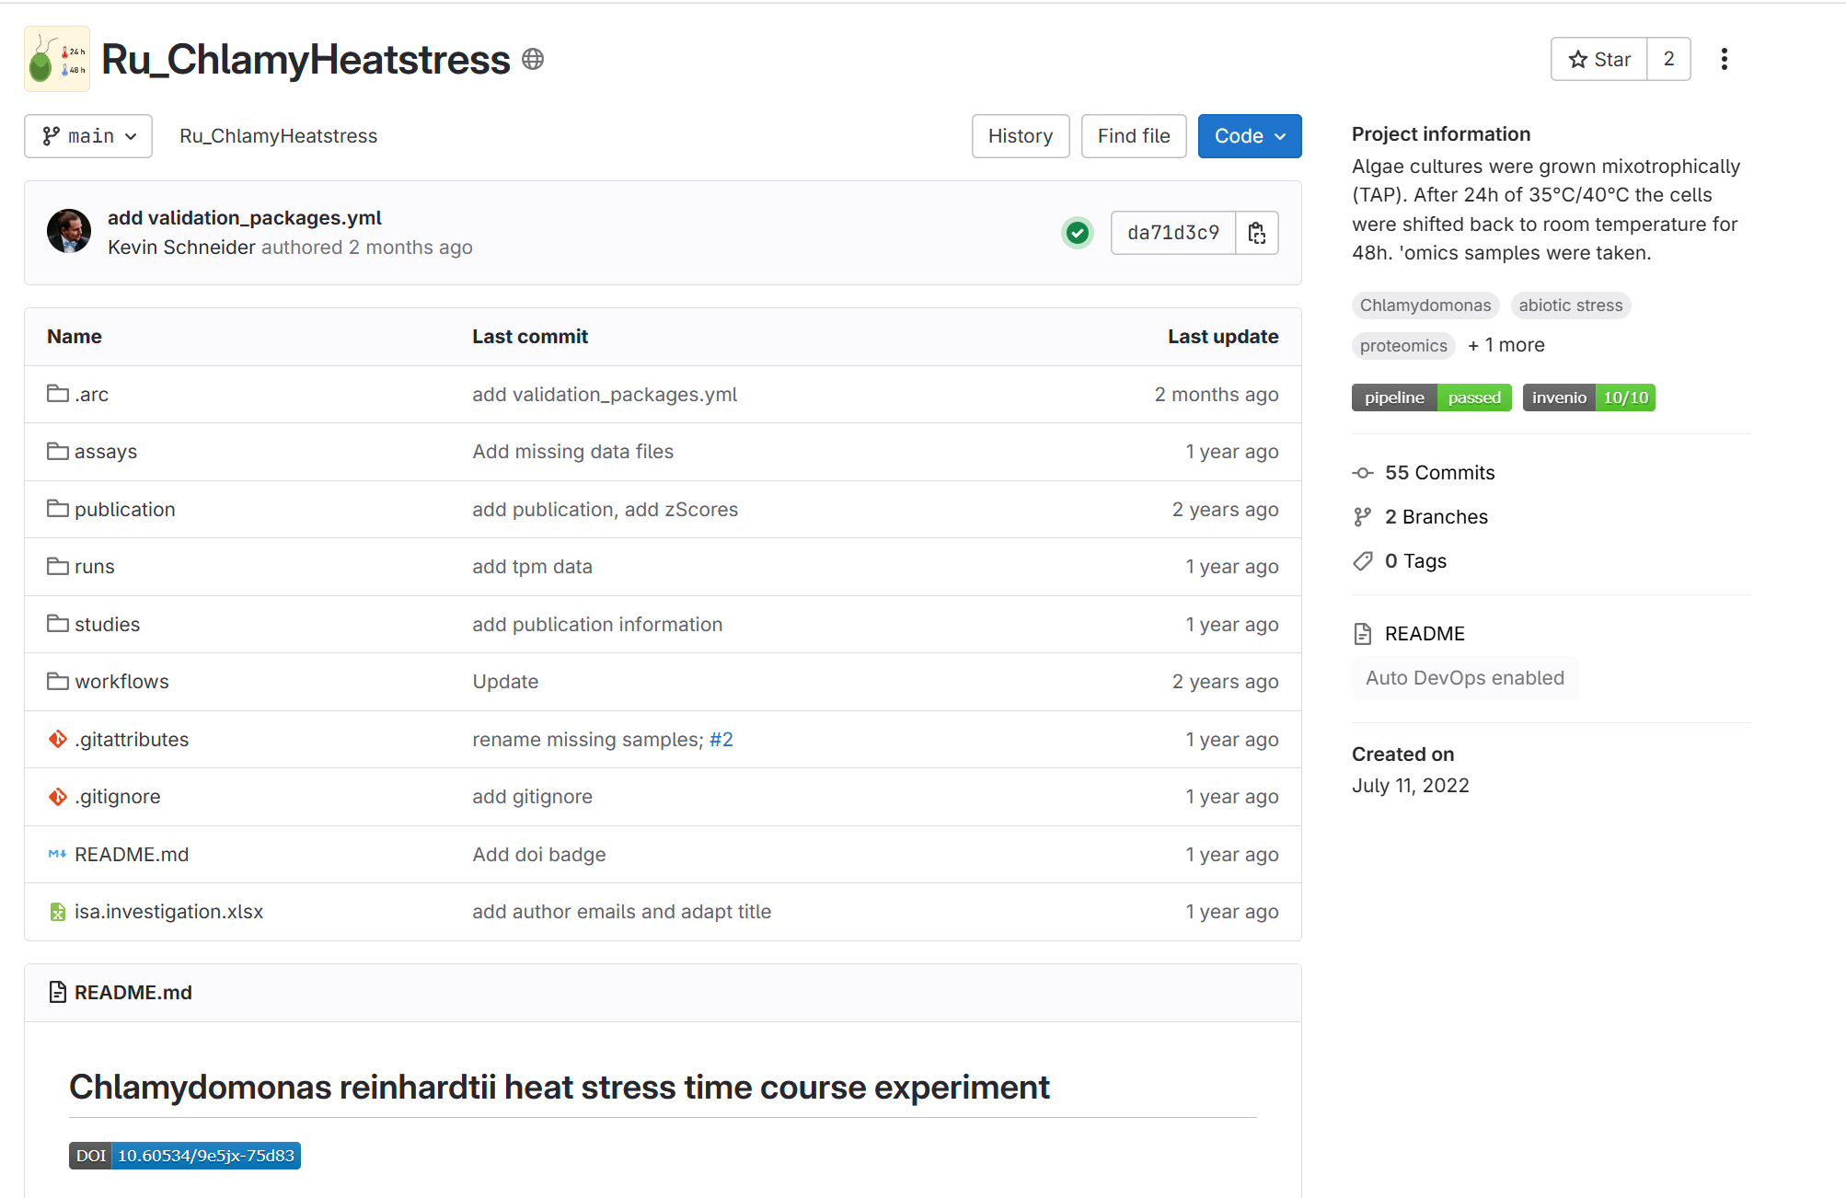
Validation towards INVENIO

Slide 6


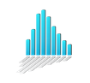
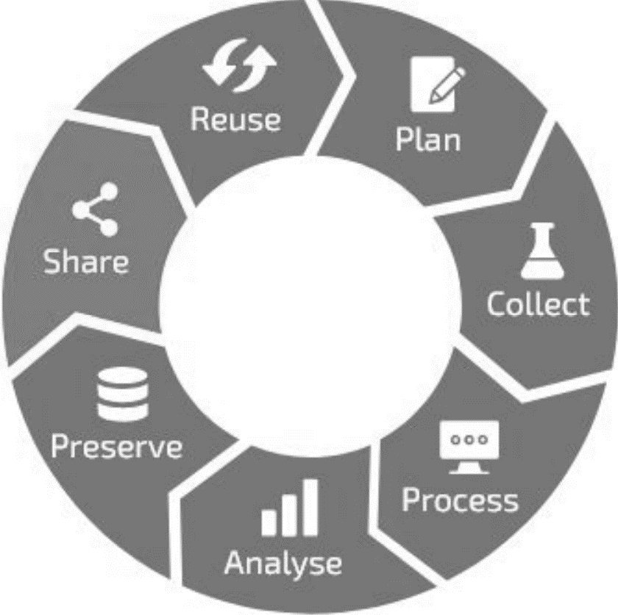


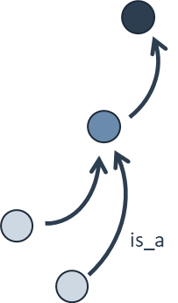





Participate in a thriving RDM ecosystem
EBI: MetaboLights
controlled vocabulary
specialized endpoints
dataset search
A
B
C
D
data publication
ARC enables researchers to participate in a thriving RDM ecosystem without barriers
Zenodo 2023 https://doi.org/10.5281/zenodo.10091038

Slide 7
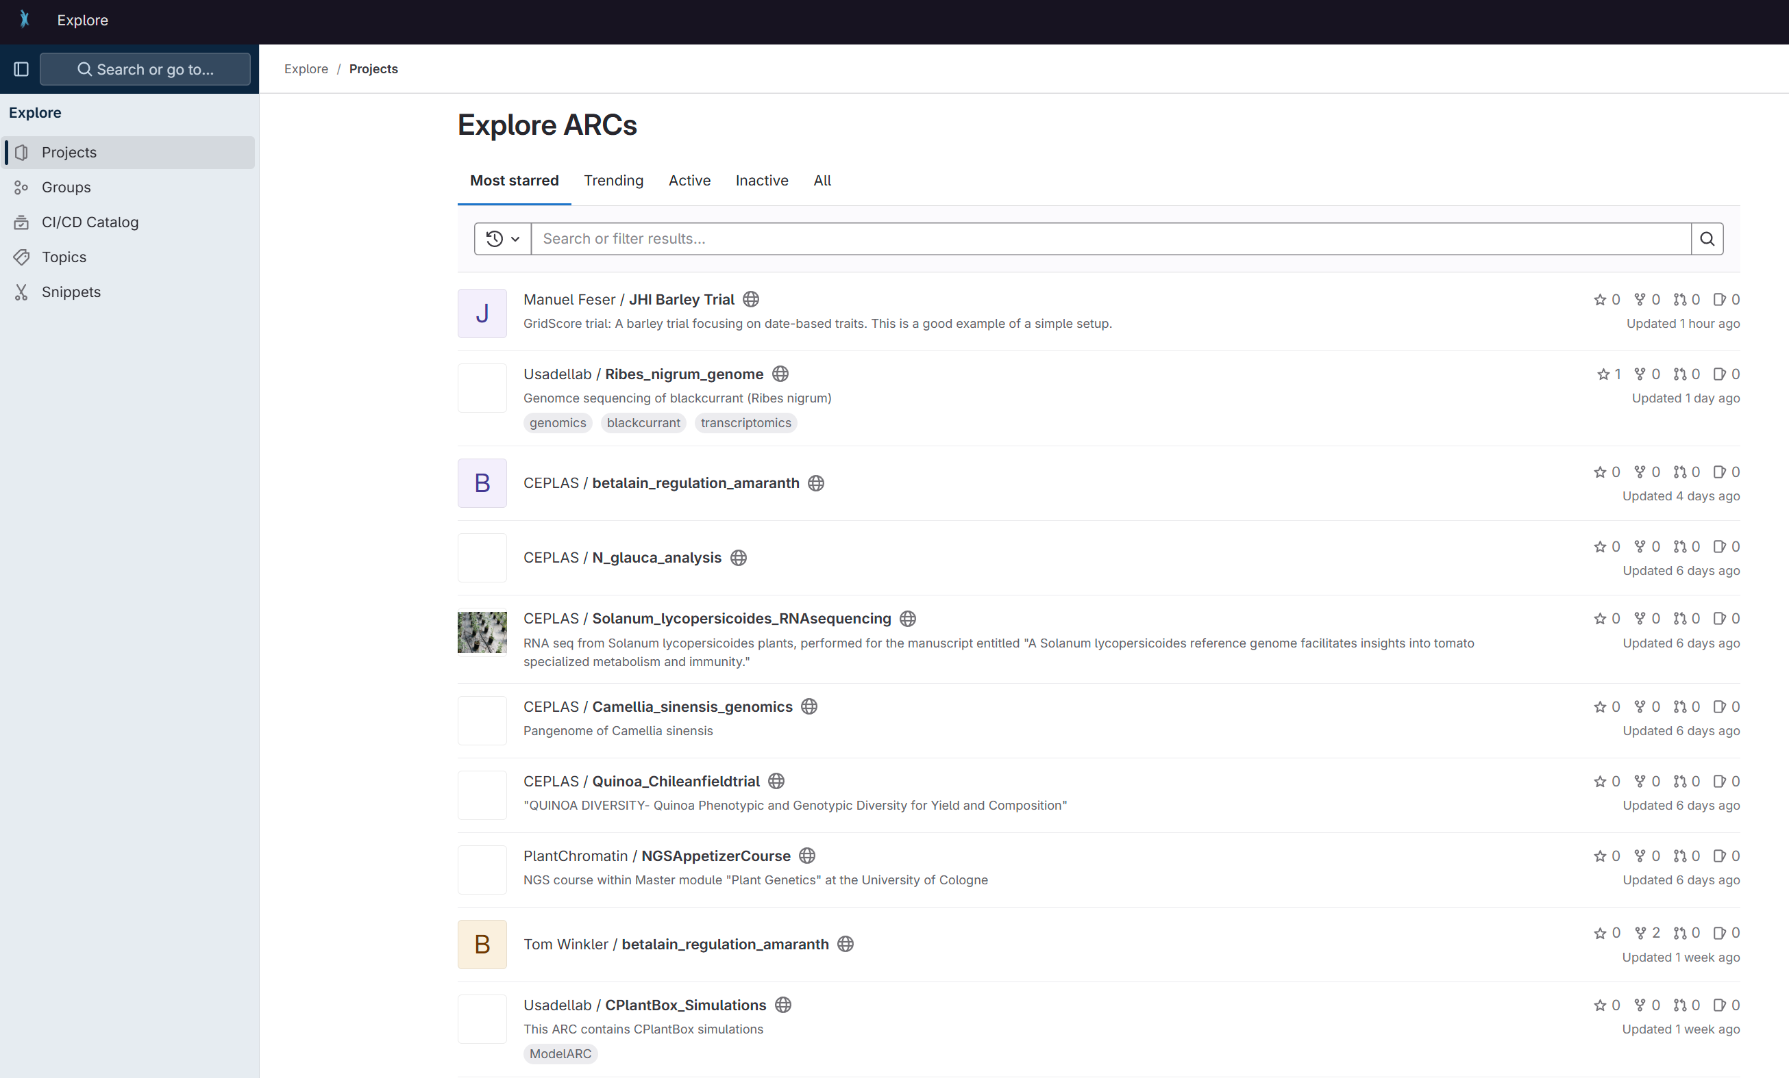
PLANTDataHUB live

Slide 8
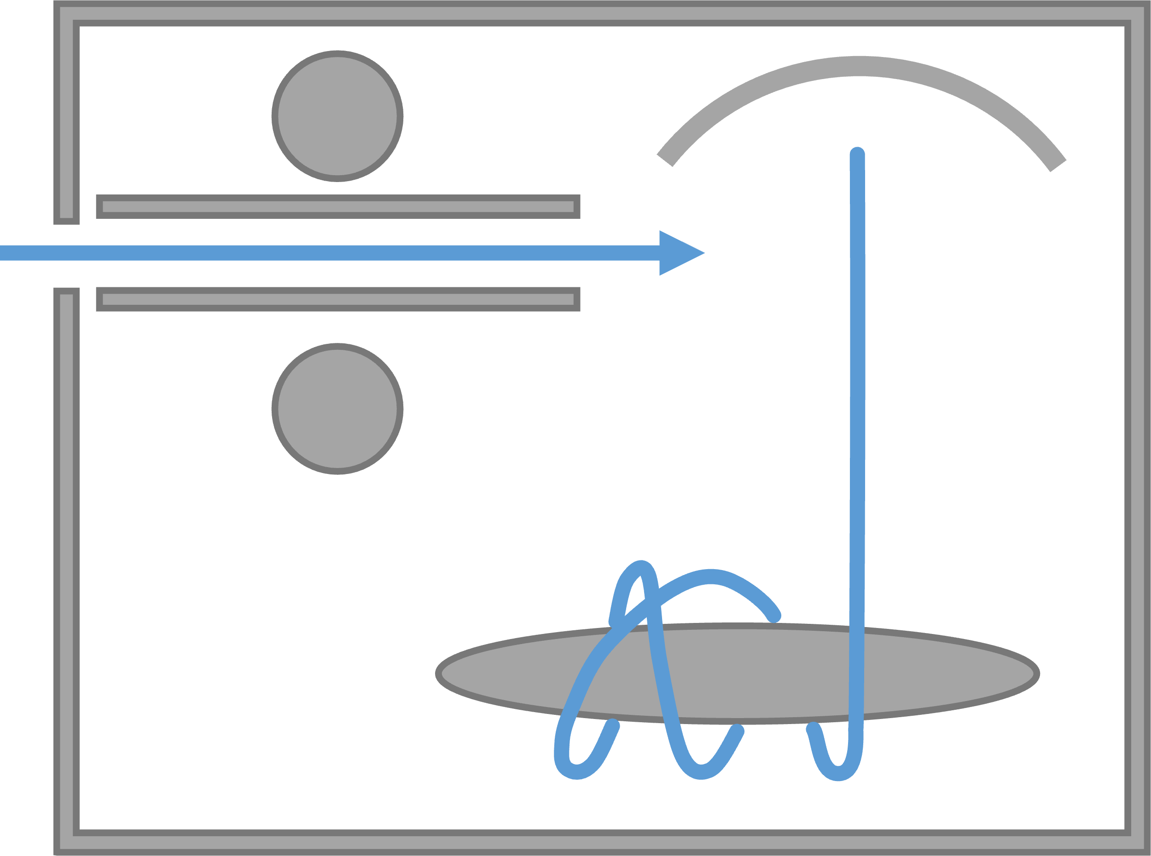
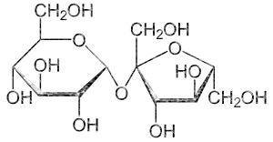
Create the second assay

Slide 9
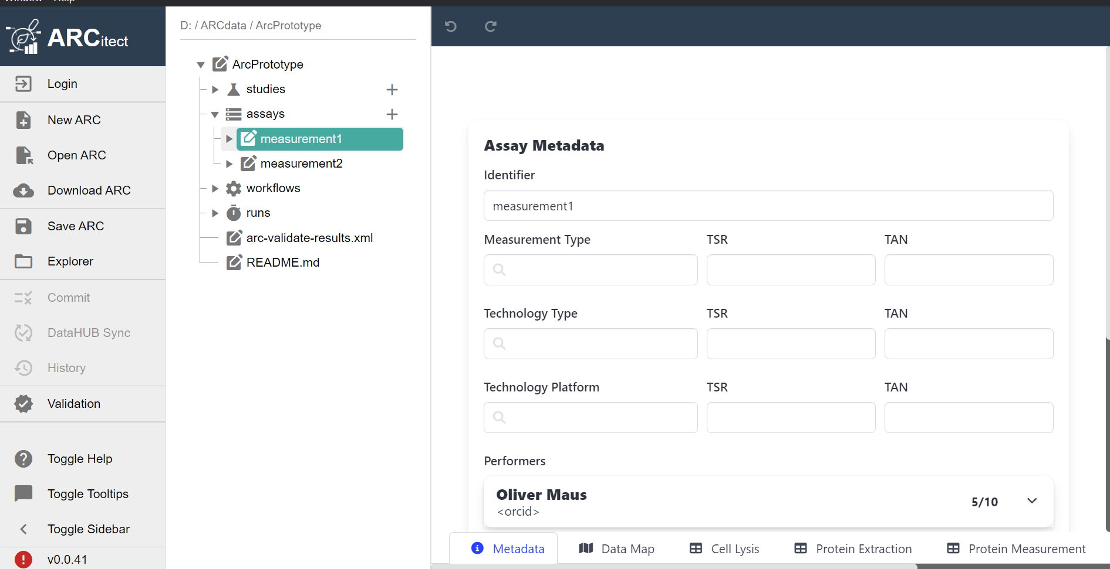
Creating a new assay
Term Source Reference
Identifier
Measurement Type
Technology Type
Technology platform
Performer
Term Accession Number

Slide 10
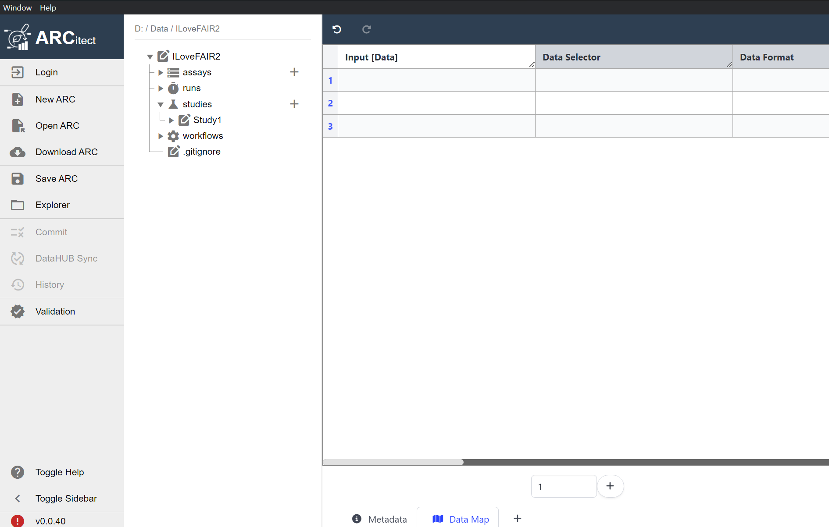
ARCitect demo time

Slide 11
Option I: Create a virtual assay

Slide 12
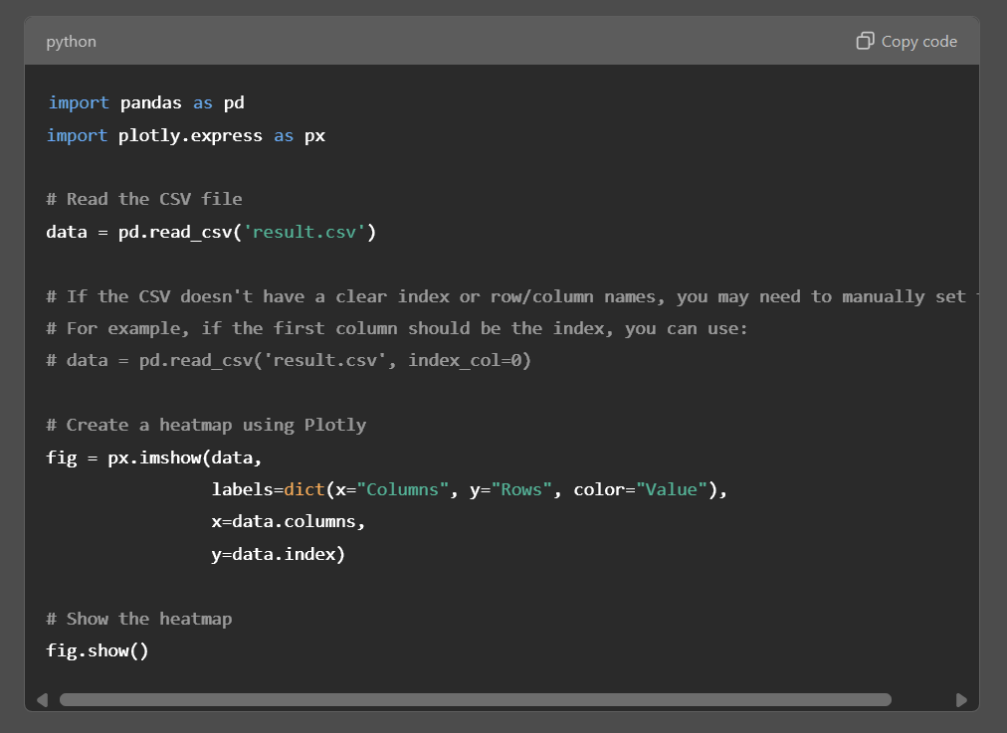
A computational workflow is like a protocol
computational workflow
computational workflow
[ ]
[ ]
result.csv
heatmap.py
result.csv
[ ]
computational workflow

Slide 13


A computational workflow is like a protocol
<study1>
resources
…
protocols
studies
<assay1>
dataset
assays
…
protocols
workflows
<workflow1>
script / code / …
…
CWL
runs
<run1>
data files
…
CWL
investigation
heatmap.py

Slide 14
Option II: Create a run and a workflow

Slide 15
A computational workflow is workflow
computational workflow
computational workflow
[ ]
[ ]
result.csv
heatmap.py
result.csv
[ ]
computational workflow

Slide 16
A workflow maps input data into a run result
<study1>
resources
…
protocols
studies
<assay1>
dataset
assays
…
protocols
heatmap.py
workflows
<workflow1>
script / code / …
…
CWL
runs
<run1>
data files
…
CWL
investigation

Slide 17
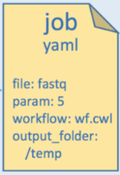
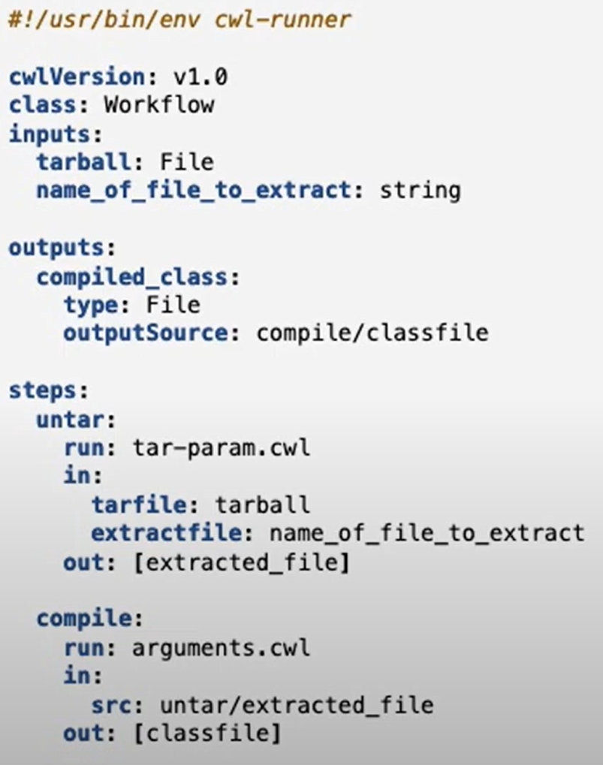

Using CWL abstract to wrap your workflow
CWL workflow document (*.cwl)
CWL job parameter (*.yaml)
1
2
3
CWL tool descriptors (*.cwl)
CWL runner

Slide 18


Build on existing well-established standards
administrative
experimental
<metadata>
CWL
computational
descriptive
structural
Integration of established (meta)data standards ensures compatibility by design

Slide 19
ARC: Annotated research context
experimental data
intensity
CAGAGGTGA
m/z
CAGAG
AGAGG
GAGGT
computation
controlled vocabulary
AGGTG
GGTGA
annotation
A
B
C
D
Your entire investigation in a single unified bag
https://github.com/nfdi4plants/ARC-specfication

Slide 20
ISA abstract model in a nutshell
Assay descriptive (meta)data information on the measurement
Characteristics
Parameters
Components
Factors
isa
Study descriptive (meta)data information on the subject
Characteristics
Parameters
Components
Factors
Investigation administrative (meta)data
Summary
Titel
Description
Person
Organisation
Publication reference
widely established within
the ‘omics community

Slide 21

Connected by similarity
administrative
investigation
isa
experimental
study
study
assay(s)
computational
CWL
+ parameter
run
result(s)

Slide 22




Support to bag your research
tooling
personal
Tools to facilitate creation and management of ARCs
On-site personnel assistance

Slide 23



DataPLANT service
Helpdesk
https://helpdesk.nfdi4plants.org/
E-Mail
info@nfdi4plants.org
Website
https://www.nfdi4plants.org/

Slide 24
Thank you for your attention

